Slide 1
GPAGER 전류 측정

Slide 2
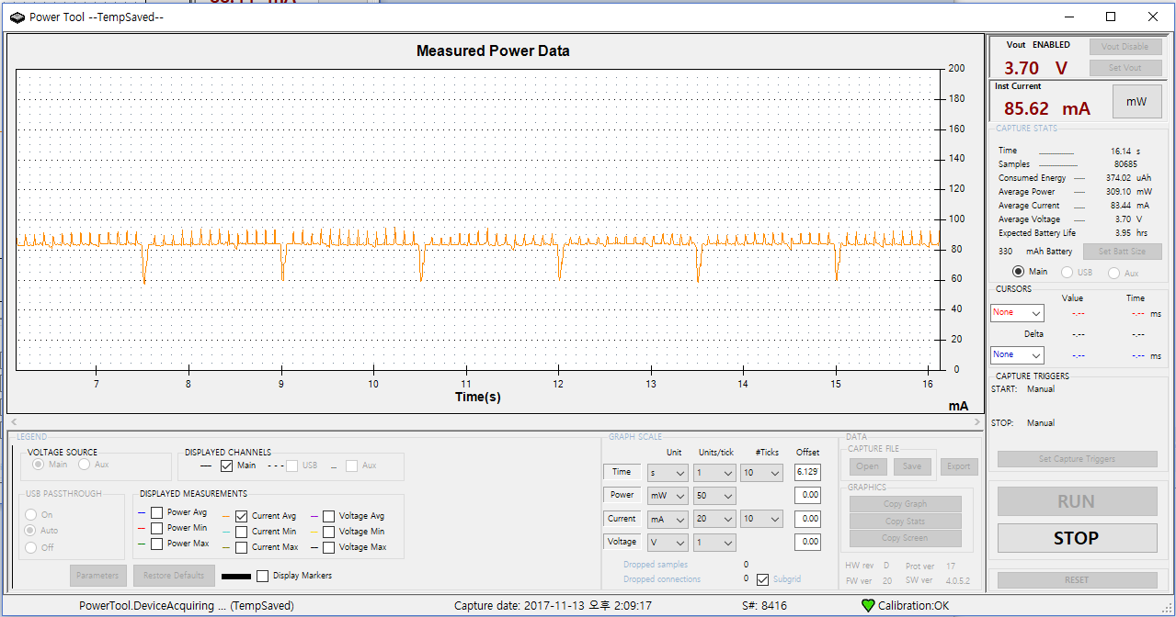
1. Average Current : 83.44 mA
Device | Status
LCD Backlight | On
LCD Display | On
GPS | On
Buzzer | Off
Vibrator | Off
LoRa Send | Off
LoRa Receive | Off

Slide 3

2. Average Current : 81.08 mA
Device | Status
LCD Backlight | Off
LCD Display | Off
GPS | On
Buzzer | Off
Vibrator | Off
LoRa Send | Off
LoRa Receive | Off

Slide 4
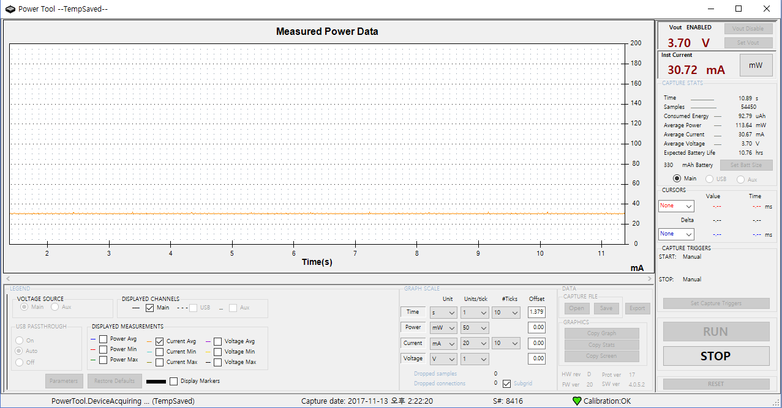
3. Average Current : 30.67 mA
Device | Status
LCD Backlight | On
LCD Display | On
GPS | Off
Buzzer | Off
Vibrator | Off
LoRa Send | Off
LoRa Receive | Off

Slide 5
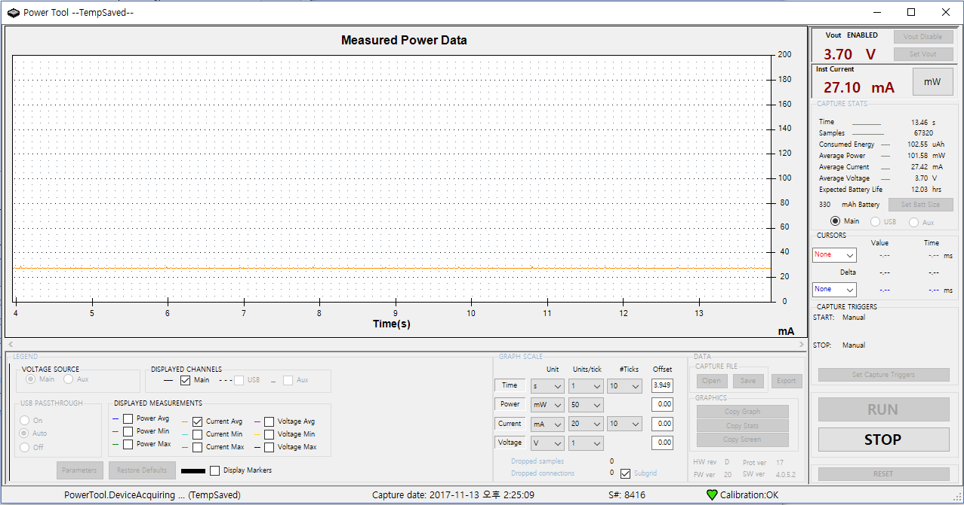
4. Average Current : 27.42 mA
Device | Status
LCD Backlight | Off
LCD Display | Off
GPS | Off
Buzzer | Off
Vibrator | Off
LoRa Send | Off
LoRa Receive | Off

Slide 6
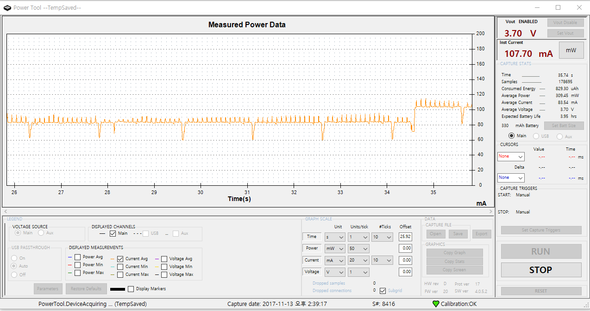
5. Current : 107.70 mA
Device | Status
LCD Backlight | On
LCD Display | On
GPS | On
Buzzer | Off
Vibrator | Off
LoRa Send | On
LoRa Receive | Off

Slide 7
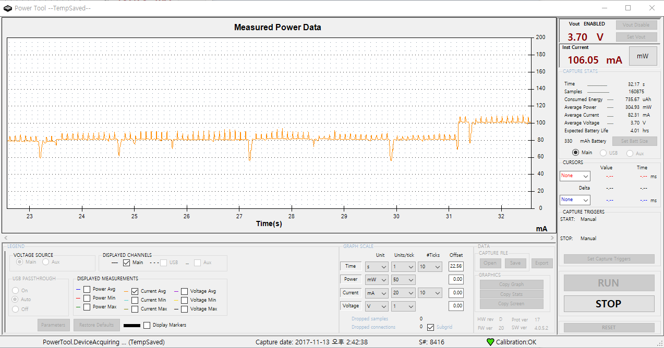
6. Current : 106.05 mA
Device | Status
LCD Backlight | Off
LCD Display | Off
GPS | On
Buzzer | Off
Vibrator | Off
LoRa Send | On
LoRa Receive | Off

Slide 8
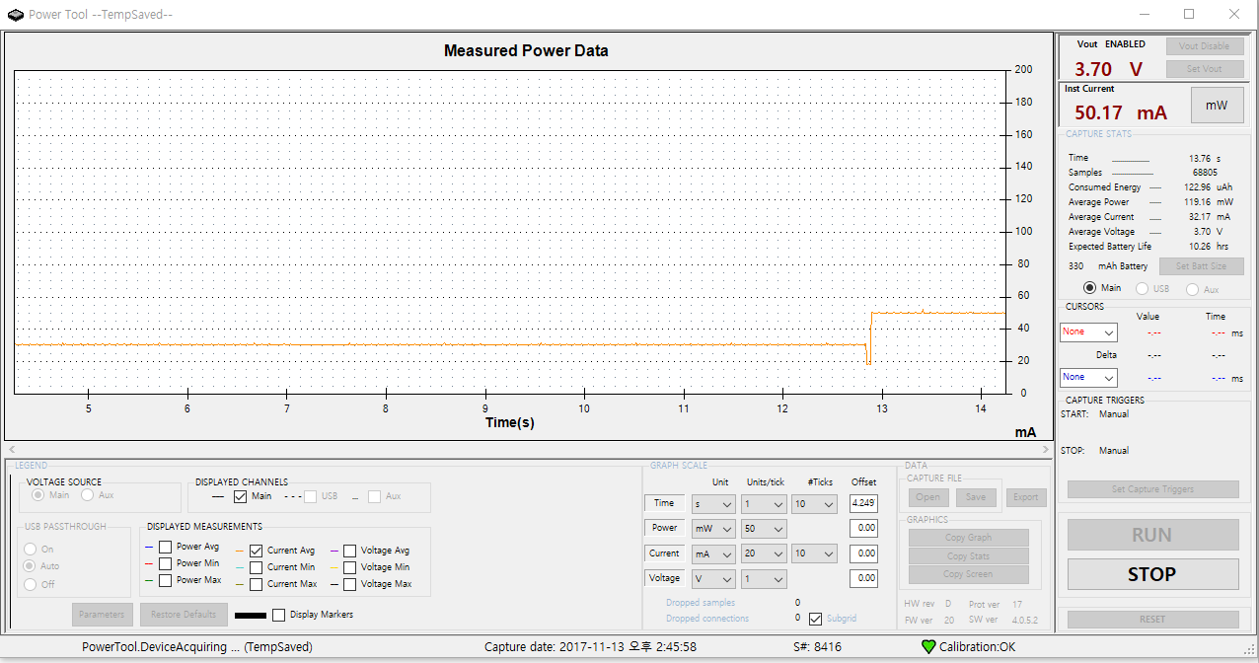
7. Current : 50.17 mA
Device | Status
LCD Backlight | On
LCD Display | On
GPS | Off
Buzzer | Off
Vibrator | Off
LoRa Send | On
LoRa Receive | Off

Slide 9
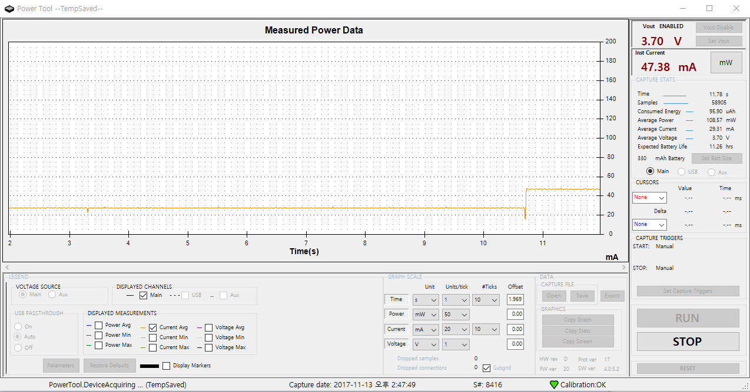
8. Current : 47.38 mA
Device | Status
LCD Backlight | Off
LCD Display | Off
GPS | Off
Buzzer | Off
Vibrator | Off
LoRa Send | On
LoRa Receive | Off

Slide 10
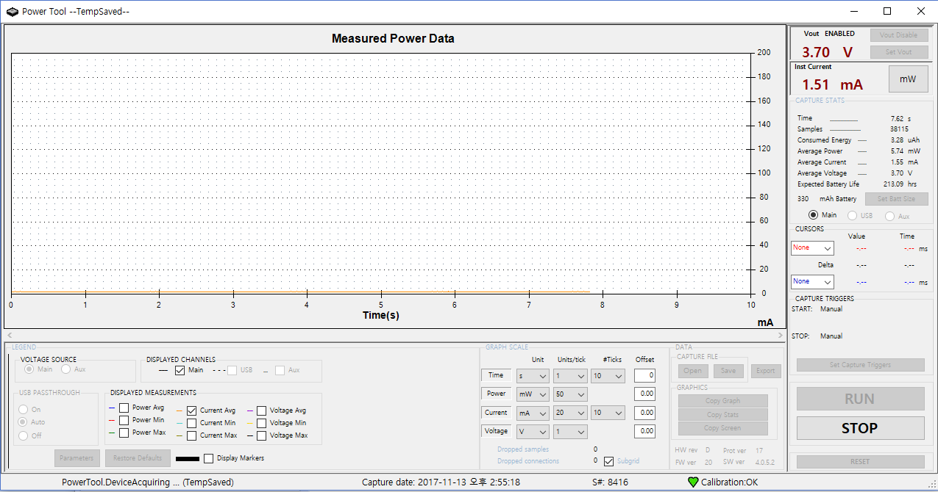
8. Power OFF Average Current : 1.55 mA

